Slide 1

Customer Complaints on Financial Products.
2017 - 2023
BY Augusta Imo-jack

Slide 2
Overview
This analysis is centered around the complaints of customers on financial products & services for Bank of America from 2017 to 2023, including the dates the complaint was submitted to the Consumer Financial Protection Bureau (CFPB) and then sent to the company, the product, the issue mentioned in the complaint, and the company's response.
The analytics driven solutions in this presentation, will provide further insights into the consumer complaints data and show areas that can enhance customer experience.

Slide 3






KPI For This Analysis
Number of Complaint
This is the total number of
Complains, sent via different mediums to the bank by customers.
Seasonal Patterns
Performance analysis based on product; number of complaints received by different methods quarterly.
Timely Response
This shows how timely each of the complaints are responded to by the company.
Company Response
How the bank typically responds to customers complaints.
Common Issues
Summary of the most frequent issue, based on each product.

Slide 4











Financial Products
Checking and saving account.
Credit Card and Prepaid Card.
Payday Loan, Title Loan, or Personal Loan.
Credit Reporting and Credit Repair service, or other personal consumer services.
Vehicle Loan or Lease.
Debt Collection.
Money Transfer, Virtual Currency or Money Service.
Mortgage.
Student Loan.

Slide 5
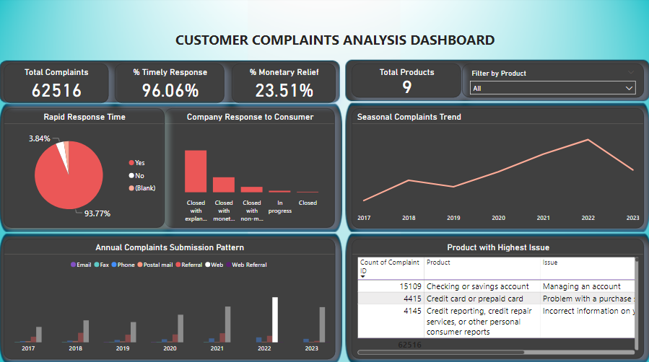

Slide 6
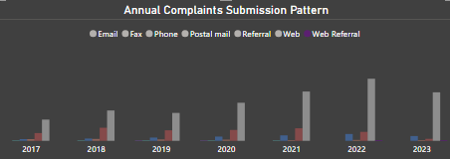
2017 - 2023 Consumer Complaints
This chart shows different method through which consumers send in their complaints. The highest is through the bank’s website, which means a lot of consumers are using the online banking platform, which is a great development for the bank.

Slide 7
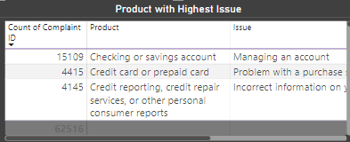
The Product With Highest Consumer Complaint.
Checking or savings account is the product with the highest consumer complaint, with “managing accounts” as the most frequent issue
.
This could be due to insufficient details on this product to the public, to enable the consumer manage their account online without any confusion.

Slide 8
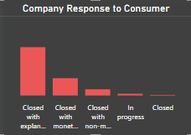
How Complaints Are Typically Resolved.
Responses are usually sent in five (5) different ways to the consumer, and the most frequent one is “Closed with explanation”. This type of response lacks clarity, so more details needs to be added to the response in future.
The analysis also shows that 24% of responses are closed with monetary relief.

Slide 9
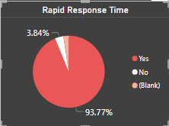
Timely and Untimely Responses.
Responses are sent to the consumer on time, as seen from the pie chart. Which is a plus for the bank, but there are some pending complaints that are yet to be responded to by the company. All complaints either customers or public needs a response. Additionally, those responses “closed with explanation” should have further clarifications in the future.

Slide 10
Insights.
Highlights
Lowlights
Responses are sent to the consumer in a timely manner, with explanations.
Most complaints were sent through the web, which means a lot of customers are using the banks website to send their complaints.
Only one product have major issues.
Responses should have more detailed explanations about the issues and the percentage of responses with monetary relief needs to be considered.
Insufficient information is provided on the website, which results to more complaints being sent.
Checking and Saving account products needs to be investigated, alongside its major issue.

Slide 11

Recommendations
Maintain timely response to complaints.
Help customers navigate their complaints handling procedures.
Avoid using misleading terms, while advertising the products.
Correlate and integrate internal and external complaints.
Understand the touch points and gaps in meeting customers expectations
Internal product training, to provide clarity and proper product management.

Slide 12
Thank you
Questions?

